Slide 1

© 2002, Cisco Systems, Inc. All rights reserved.

Slide 2

Distance Vector Routing
© 2002, Cisco Systems, Inc. All rights reserved.
Notes:
Purpose: This chapter introduces the Cisco IOS™ CLI on the Catalyst® 1900 switch and router.
Timing: This chapter should take about 2 hours to present.
Note: The Catalyst 1900 switch only has a subset of the router Cisco IOS commands available.
Contents:
Introduction to Cisco IOS. Explain to the student what is IOS?
Cisco Device startup procedures in general.
IOS configuration source.
General introduction to the IOS CLI.
Cat 1900 switch startup procedures.
Intro to Cat 1900 CLI. This part covers the basic configuration on the switch, like setting the IP address and hostname. More details about the various Cat 1900 switch configuration commands are explained in Chapter 6 and 7.
Router startup procedures. More details on the router startup process is discussed in chapter 5.
Router IOS CLI.

Slide 3
Objectives
Upon completing this lesson, you will be able to:
  Describe the features offered by distance vector routing protocols and give examples of each
  Describe the issues associated with distance vector routing and identify solutions to those issues
Notes:
Slide 1 of 2
Purpose: This slide states the chapter objectives.
Emphasize: Read or state each objective so that each student has a clear understanding of the chapter objectives.
Note: Catalyst switches have different CLIs. The Catalyst 2900xl and the Catalyst 1900 has a Cisco IOS CLI. The Cisco IOS CLI commands available on the 2900xl is different from the 1900. The Catalyst 5000 family has no Cisco IOS CLI, and use the set commands instead. This class only covers the configuration on the Catalyst 1900 switch.

Slide 4
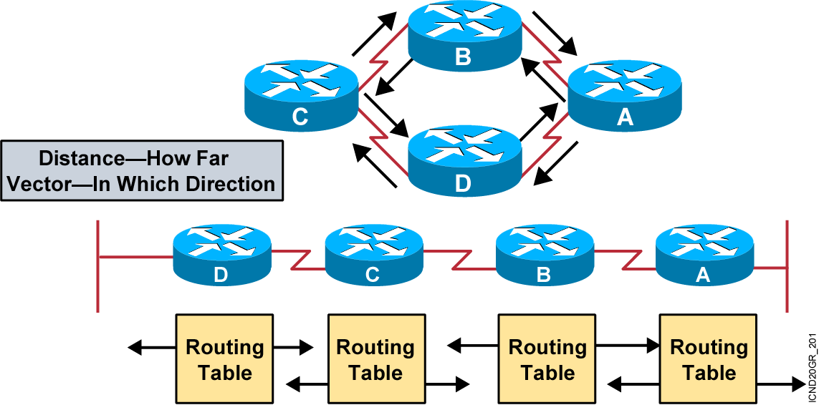
Distance Vector Routing Protocols
Routers pass periodic copies of routing table to neighbor
routers and accumulate distance vectors.
Notes:
Purpose: This figure introduces the distance vector routing algorithm, the first of the classes of routing protocols, and outlines how it operates.
Emphasize: Distance vector algorithms do not allow a router to know the exact topology of an internetwork.
This information is somewhat analogous to the information found on signs at a highway intersection. A sign points toward a road leading away from the intersection and indicates the distance to the destination.
Further down the highway, another sign also points toward the destination, but now the distance to the destination is shorter.
As long as each successive point on the path shows that the distance to the destination is successively shorter, the traffic is following the best path.

Slide 5
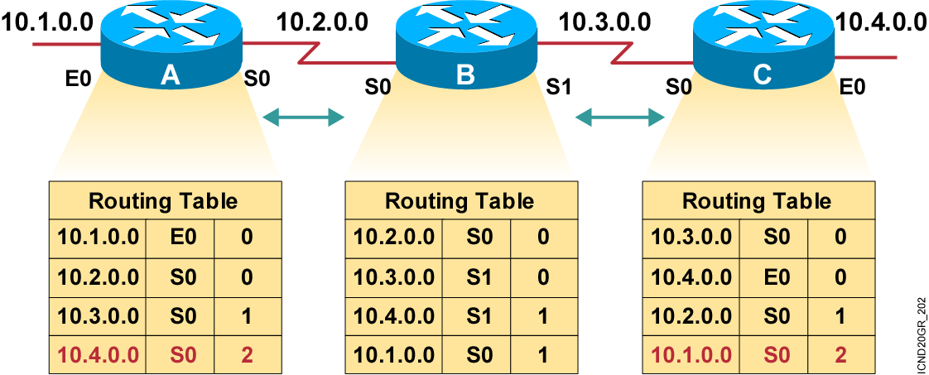
Sources of Information and Discovering Routes
Routers discover the best path to
destinations from each neighbor.
Notes:
Layer 3 of 3
Emphasize: Layer 3 adds the final entries received some time later that have distances of 2 from routers A and C.

Slide 6
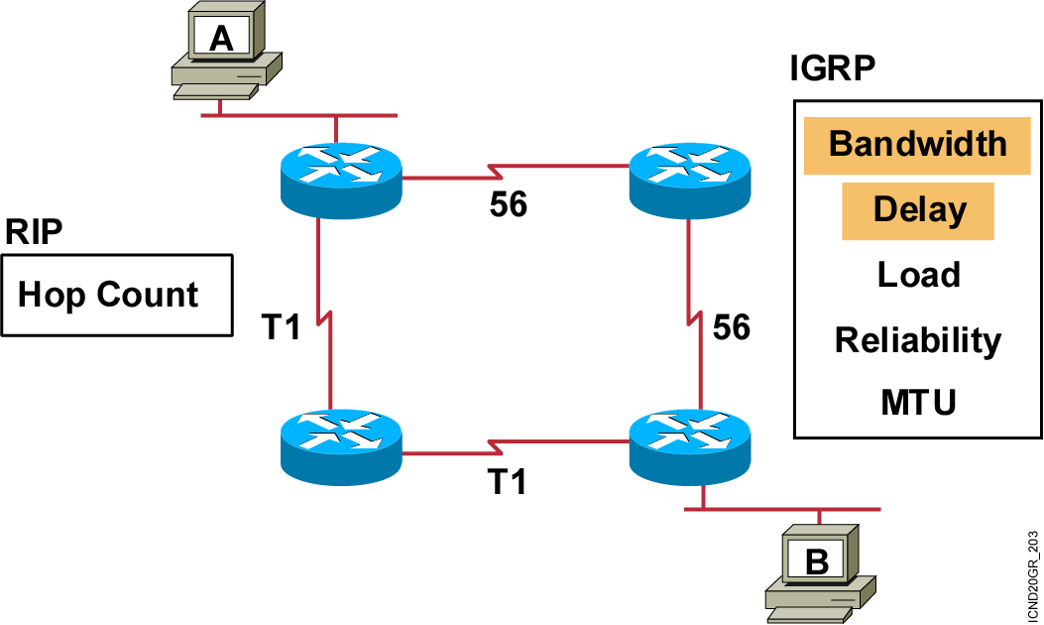
Selecting the
Best Route with Metrics
Notes:
Emphasize: How the routing algorithm defines “best” determines the most important characteristics of each routing algorithm.
Hop count—Some routing protocols use hop count as their metric. Hop count refers to the number of routers a packet must go through to reach a destination. The lower the hop count, the better the path. Path length is used to indicate the sum of the hops to a destination. As indicated in the figure, RIP uses hop count for its metric.
Ticks—Metric used with Novell IPX to reflect delay. Each tick is 1/18th of a second.
Cost—Factor used by some routing protocols to determine the best path to a destination; the lower the cost, the better the path. Path cost is the sum of the costs associated with each link to a destination.
Bandwidth—Although bandwidth is the rating of a link’s maximum throughput, routing through links with greater bandwidth does not always provide the best routes. For example, if a high-speed link is busy, sending a packet through a slower link might be faster. As indicated in the figure with highlighting, delay and bandwidth comprise the default metric for IGRP.
Delay—Depends on many factors, including the bandwidth of network links, the length of queues at each router in the path, network congestion on links, and the physical distance to be traveled. A conglomeration of variables that change with internetwork conditions, delay is a common and useful metric. As indicated in the figure with highlighting, delay and bandwidth comprise the default metric for IGRP.
Load—Dynamic factor can be based on a variety of measures, including CPU use and packets processed per second. Monitoring these parameters on a continual basis can itself be resource intensive.

Slide 7
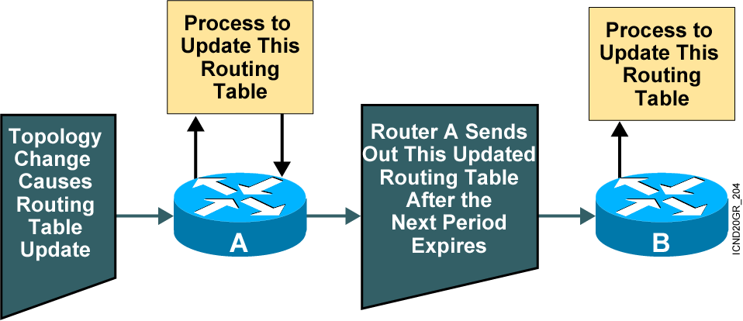
Maintaining Routing Information
Updates proceed step-by-step
from router to router.
Notes:
Layer 3 of 3
Layer 3 adds router B, which receives the updated routing table from router A. In turn, router B will perform its own process to update its routing table given this new topology update from router A.
Distance vector updates occur step by step.
Typically, a router sends updates by multicasting its table on each configured port, but other methods, such as sending the table only to preconfigured neighbors, are employed by some routing algorithms.
Multicast is used by the RIP2, OSPF, and EIGRP routing protocols. RIP and IGRP use broadcast.
The routing table can be sent routinely and periodically, or whenever a change in the topology is discovered. Updates sent when changes occur are called triggered updates.

Slide 8
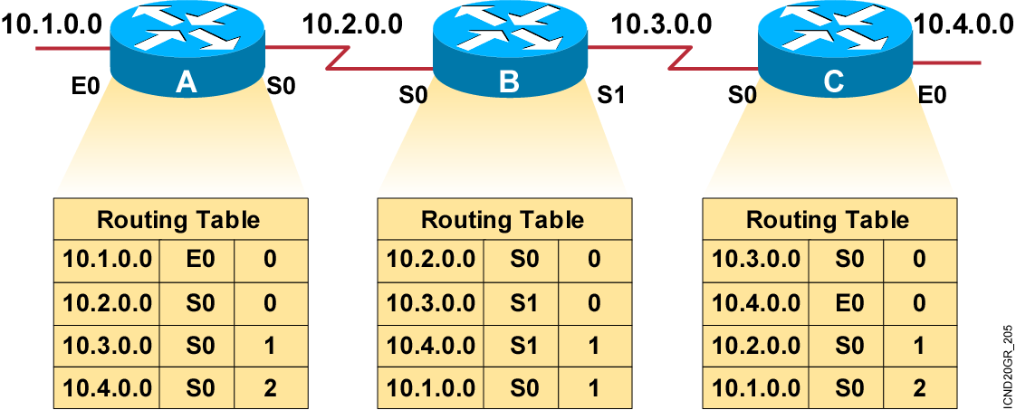
Inconsistent Routing Entries
Each node maintains the distance from itself to each possible destination network.
Notes:
Slide 1 of 4
Purpose: This figure describes the first of the general problems that a distance vector protocol could face without the corrective influence of some countermeasure.
Emphasize: Layer 1 shows the original state of the network and routing tables. All routers have consistent knowledge and correct routing tables. In this example, the cost function is hop count, so the cost of each link is 1. Router C is directly connected to network 10.4.0.0 with a distance of 0. Router A’s path to network 10.4.0.0 is through router B, with a hop count of 2.

Slide 9
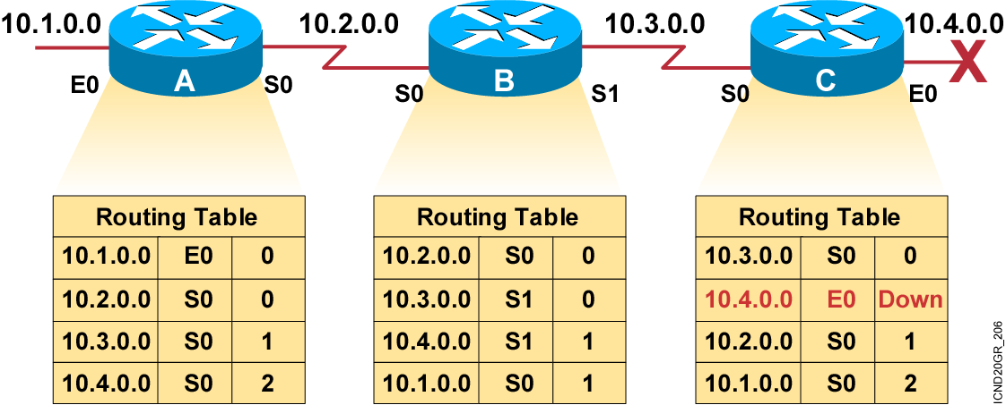
Inconsistent Routing Entries (Cont.)
Slow convergence produces inconsistent routing.
Notes:
Slide 2 of 4
Emphasize: In Layer 2, router C has detected the failure of network 10.4.0.0 and stops routing packets out its E0 interface. However, router A has not yet received notification of the failure and still believes it can access network 10.4.0.0 through router B. Router A’s routing table still reflects a path to network 10.4.0.0 with a distance of 2.

Slide 10
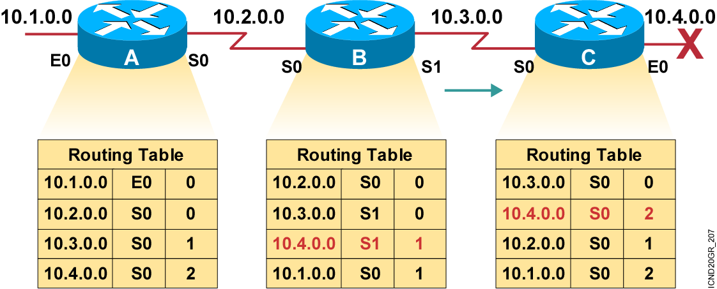
Inconsistent Routing Entries (Cont.)
Router C concludes that the best path to network 10.4.0.0 is through router B.
Notes:
Slide 3 of 4
Emphasize: Because router B’s routing table indicates a path to network 10.4.0.0, router C believes it now has a viable path to 10.4.0.0 through router B. Router C updates its routing table to reflect a path to network 10.4.0.0 with a hop count of 2.

Slide 11
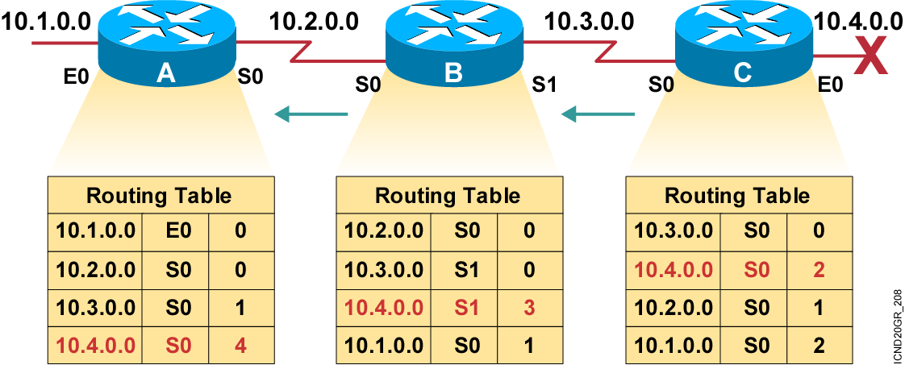
Inconsistent Routing Entries (Cont.)
Router A updates its table to reflect the new but erroneous hop count.
Notes:
Slide 4 of 4
Emphasize: In Layer 4, router A receives the new routing table from router B, detects the modified distance vector to network 10.4.0.0, and recalculates its own distance vector to network 10.4.0.0 as 3.
If all routers in an internetwork do not have up-to-date, accurate information about the state of the internetwork, they might use incorrect routing information to make a routing decision.
The use of incorrect information might cause packets to take less-than-optimum paths or paths that return packets to routers that they have already visited.

Slide 12
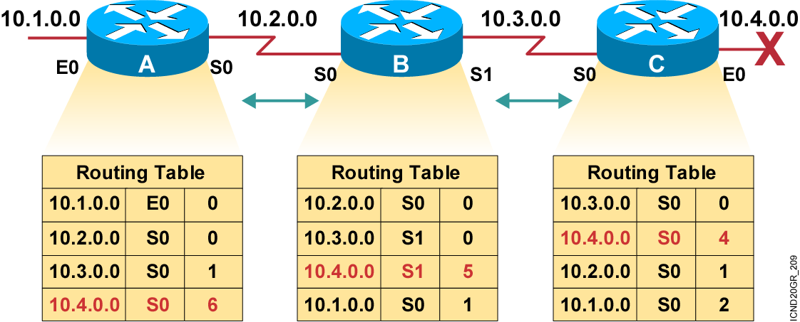
Count to Infinity
Hop count for network 10.4.0.0 counts to infinity.
Notes:
Purpose: This figure describes another of the general problems that a distance vector protocol could face without the corrective influence of some countermeasure.
Emphasize: Both routers conclude that the best path to network 10.4.0.0 is through each other and continue to bounce packets destined for network 10.4.0.0 between each other, incrementing the distance vector by 1 each time.
This condition, called count to infinity, continuously loops packets around the network, despite the fundamental fact that the destination network 10.4.0.0 is down. While the routers are counting to infinity, the invalid information allows a routing loop to exist.
A related concept is the Time-to-Live (TTL) parameter. The TTL is a packet parameter that decreases each time a router processes the packet. When the TTL reaches zero, a router discards or drops the packet without forwarding it. A packet caught in a routing loop is removed from the internetwork when its TTL expires.

Slide 13
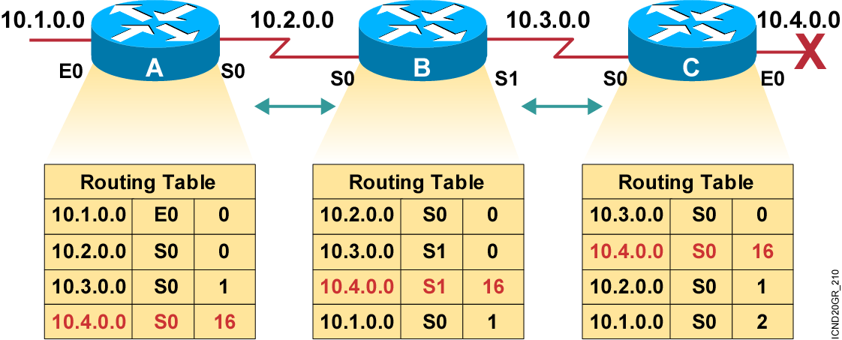
Defining a Maximum
Define a limit on the number of hops to prevent infinite loops.
Notes:
Purpose: This figure describes a corrective measure that attempts to solve the routing loop problems that a distance vector protocol could face.
Emphasize: Routing loops occur only when routing knowledge being propagated has not yet reached the entire internetwork—when the internetwork has not converged after a change. Fast convergence minimizes the chance for a routing loop to occur, but even the smallest interval leaves the possibility open.
To avoid prolonging the count-to-infinity time span, distance vector protocols define infinity as some maximum number. This number refers to a routing metric, such as a hop count.
With this approach, the routing protocol permits the routing loop until the metric exceeds its maximum allowed value. This example shows this defined maximum as 16 hops. Once the metric value exceeds the maximum, network 10.4.0.0 is considered unreachable.

Slide 14
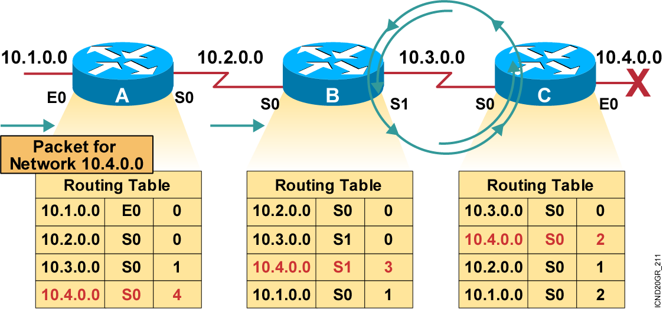
Routing Loops
Packets for network 10.4.0.0 bounce (loop) between routers B and C.
Notes:
Slide 4 of 4
Emphasize: In Layer 4, router A receives the new routing table from router B, detects the modified distance vector to network 10.4.0.0, and recalculates its own distance vector to network 10.4.0.0 as 3.
If all routers in an internetwork do not have up-to-date, accurate information about the state of the internetwork, they might use incorrect routing information to make a routing decision.
The use of incorrect information might cause packets to take less-than-optimum paths or paths that return packets to routers that they have already visited.

Slide 15
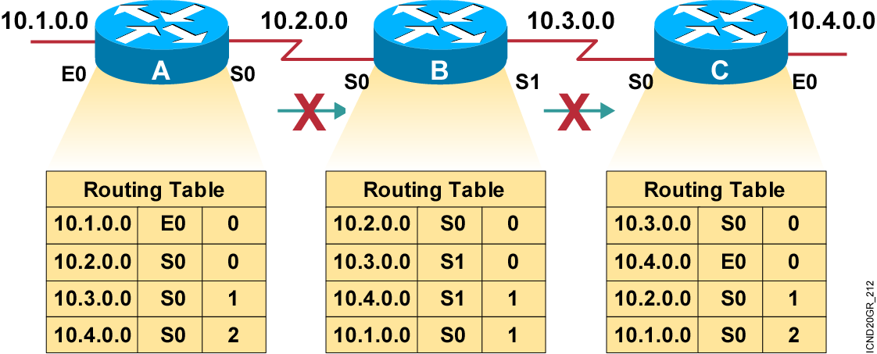
Split Horizon
It is never useful to send information about a route back in the direction from which the original information came.
Notes:
Purpose: This figure introduces the corrective measure known as “split horizon.” The split horizon technique attempts to solve routing loops.
Emphasize: The split horizon technique attempts to eliminate routing loops and speed up convergence. The rule of split horizon is that it is never useful to send information about a route back in the direction from which the original packet came. In the example:
Router C originally announced a route to network 10.4.0.0 to router B. It makes no sense for router B to announce to router C that router B has access to network 10.4.0.0 through router C.
Given that router B passed the announcement of its route to network 10.4.0.0 to router A, it makes no sense for router A to announce its distance from network 10.4.0.0 to router B.
Because router B has no alternative path to network 10.4.0.0, router B concludes that network 10.4.0.0 is inaccessible.
In its basic form, the split-horizon technique simply omits from the message any information about destinations routed on the link. This strategy relies either on routes never being announced or on old announcements fading away through a timeout mechanism.
Split horizon also improves performance by eliminating unnecessary routing updates. Under normal circumstances, sending routing information back to the source of the information is unnecessary.

Slide 16
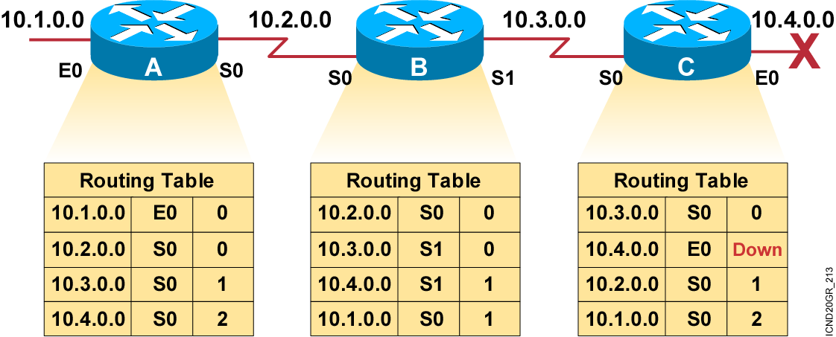
Route Poisoning
Routers advertise the distance of routes that have gone down to infinity.
Notes:
Purpose: This figure expands on the split-horizon technique by adding the concept of poisonous reverse updates.
Emphasize: Route poisoning closes the potential for longer routing loops. Fast convergence minimizes the chance for a routing loop to occur, but even the smallest interval leaves the possibility open. With a poison route in place, router B can maintain a steadfast entry that network 10.4.0.0 is indeed down.

Slide 17
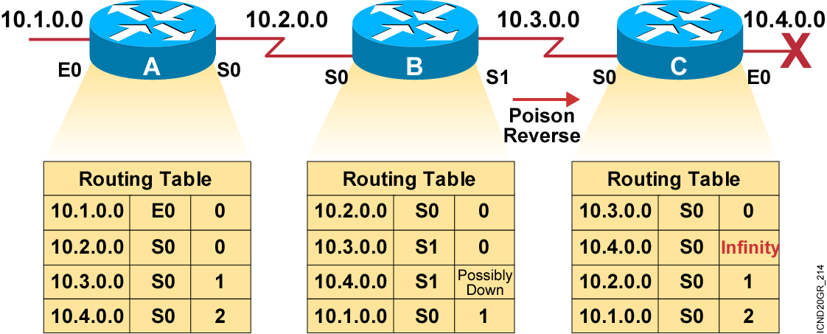
Poison Reverse
Poison reverse overrides split horizon.
Notes:
Purpose: This figure explains poison reverse.
Emphasize: Poison reverse overrides the split-horizon solution.

Slide 18
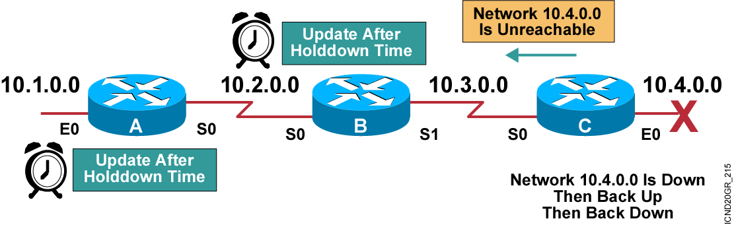
Holddown Timers
The router keeps an entry for the network’s possible down state, allowing time for other routers to recompute for this topology change.
Notes:
Purpose: This figure describes how hold-down timers avoid the general problems that a routing protocol could face.
Emphasize: Hold-down timers are used to prevent regular update messages from inappropriately reinstating a route that may have gone bad.
Hold-downs tell routers to hold any changes that might affect routes for some period of time.
The hold-down period is usually calculated to be just greater than the period of time necessary to update the entire network with a routing change.
Note: A network administrator can configure the hold-down timers on several routers to work together in tandem.

Slide 19
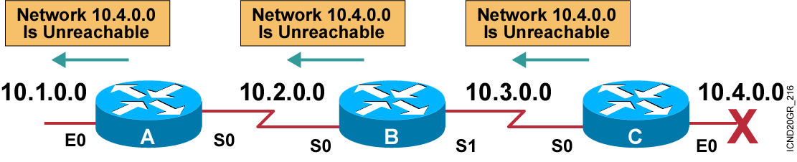
Triggered Updates
The router sends updates when a change in its routing table occurs.
Notes:
Purpose: This figure describes how triggered updates avoid the general problems that a routing protocol could face.
Emphasize: Normally, new routing tables are sent to neighboring routers on a regular basis. A triggered update is a new routing table that is sent immediately, in response to some change.
Each update triggers a routing table change in the adjacent routers, which, in turn, generate triggered updates notifying their adjacent neighbors of the change. This wave propagates throughout that portion of the network where routes went through the link.
Triggered updates would be sufficient if we could guarantee that the wave of updates reached every appropriate router immediately. However, there are two problems:
Packets containing the update message can be dropped or corrupted by some link in the network.
The triggered updates do not happen instantaneously. It is possible that a router that has not yet received the triggered update will issue a regular update at just the wrong time, causing the bad route to be reinserted in a neighbor that had already received the triggered update.
Coupling triggered updates with holddowns is designed to get around these problems. Because the hold-down rule says that when a route is removed, no new route will be accepted for the same destination for some period of time, the triggered update has time to propagate throughout the network.

Slide 20
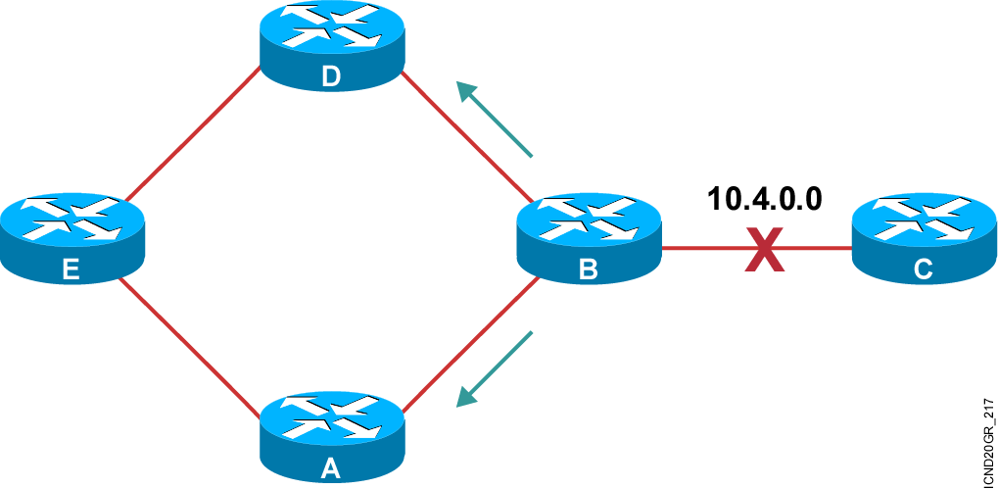
Distance Vector Operation
Notes:
Slide 1 of 6
Purpose: This page begins a series of graphics that tie all the solutions together by showing how each solution works to prevent routing loops in a more complex network design.
Emphasize: Begin this series by describing that router B poisons its route to network 10.4.0.0.

Slide 21
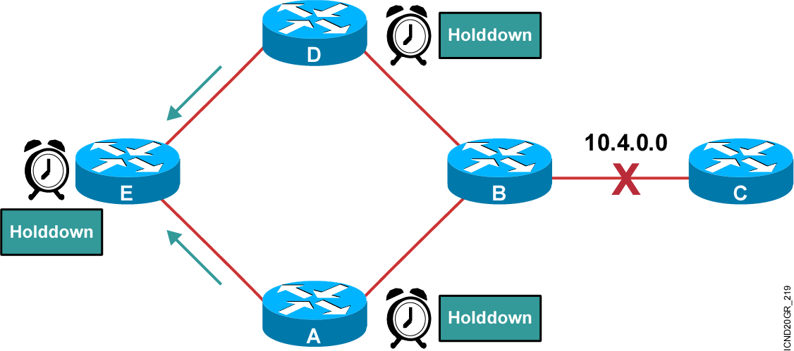
Distance Vector Operation (Cont.)
Notes:
Slide 2 of 6
Purpose: This figure continues to describe how the solution works to prevent routing loops in a more complex network design.
Emphasize: Describe that routers D and A both set their hold-down timers and send triggered updates to router E about the status of network 10.4.0.0. Router E also sets its hold-down timer.

Slide 22
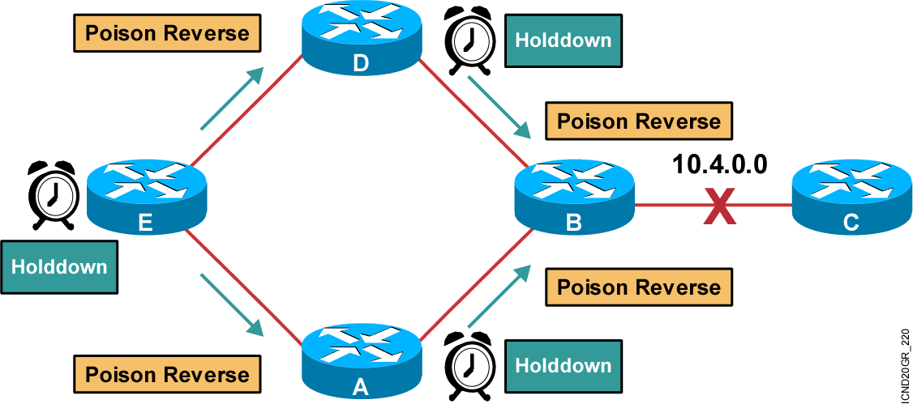
Distance Vector Operation (Cont.)
Notes:
Slide 3 of 6
Purpose: This figure continues to describe how the solution works to prevent routing loops in a more complex network design.
Emphasize: Router A and D send a poison reverse to router B. Router E sends a poison reverse to router B.

Slide 23
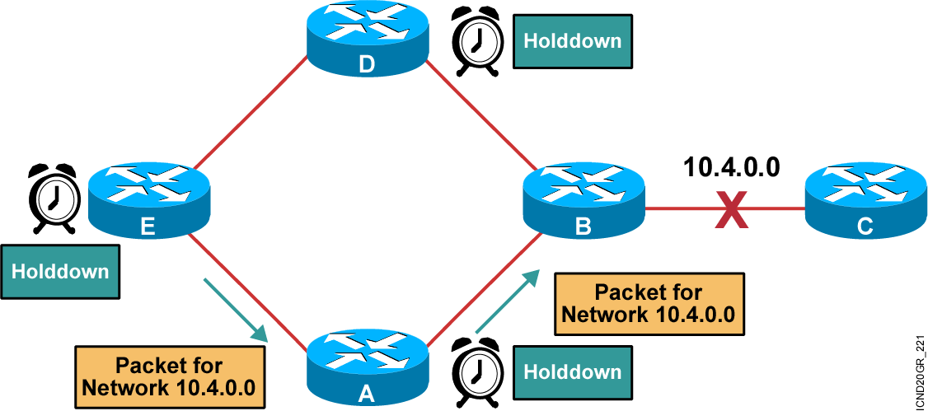
Distance Vector Operation (Cont.)
Notes:
Slide 4 of 6
Purpose: This figure continues to describe how the solution works to prevent routing loops in a more complex network design.
Emphasize: While in hold-down state, routers A, D, and E will still attempt to forward packets to network 10.4.0.0.

Slide 24
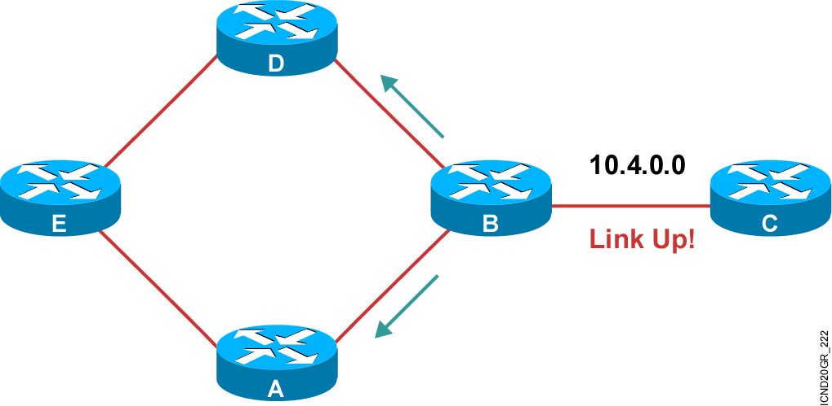
Distance Vector Operation (Cont.)
Notes:
Slide 5 of 6
Purpose: This figure continues to describe how the solution works to prevent routing loops in a more complex network design.
Emphasize: When the link is back up, router B will send a triggered update to router A and router D, notifying them that network 10.4.0.0 is active.

Slide 25
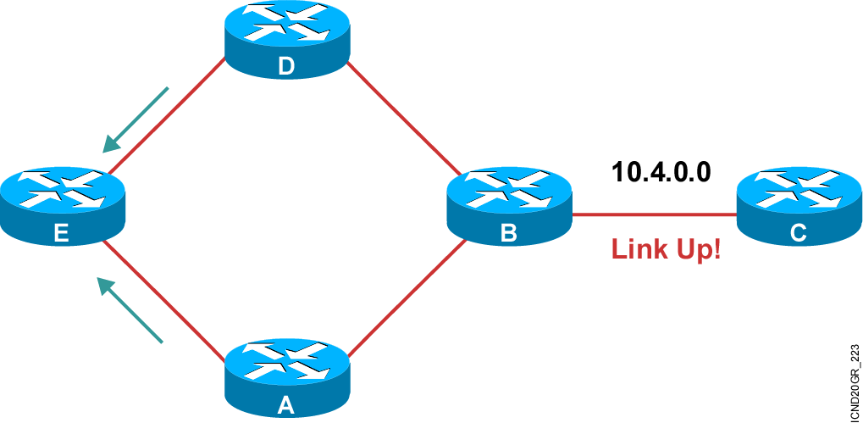
Distance Vector Operation (Cont.)
Notes:
Slide 6 of 6
Purpose: This graphic continues to describe how the solution works to prevent routing loops in a more complex network design.
Emphasize: Router A and D, in turn, update router E that network 10.4.0.0 is now up.

Slide 26
Summary
  Distance vector-based routing algorithms
  (also known as Bellman-Ford algorithms) pass periodic copies of a routing table from router to router.
  When the topology in a distance vector protocol internetwork changes, routing table updates must occur. As with the network discovery process, topology change updates proceed step-by-step from router to router.
  When maintaining the routing information, inconsistencies can occur if the internetwork’s slow convergence on a new configuration causes incorrect routing entries.
Notes:
Purpose: This slide discuss the initial configurations on the routers and switches.
Note: There is no setup mode on the Catalyst 1900 switch.

Slide 27
Summary (Cont.)
  The condition called count to infinity arises when routing table updates continue to increase the metric to a destination that cannot be reached, rather than marking the destination as unreachable.
  A routing loop occurs when two or more routers have incorrect routing information indicating that a valid path to an unreachable destination exists through the other routers.
  A number of techniques are available to eliminate routing loops including: split horizon, route poisoning, poison reverse, holddown timers, and triggered updates.
Notes:
Purpose: This slide discuss the initial configurations on the routers and switches.
Note: There is no setup mode on the Catalyst 1900 switch.

Slide 28


